Slide 1
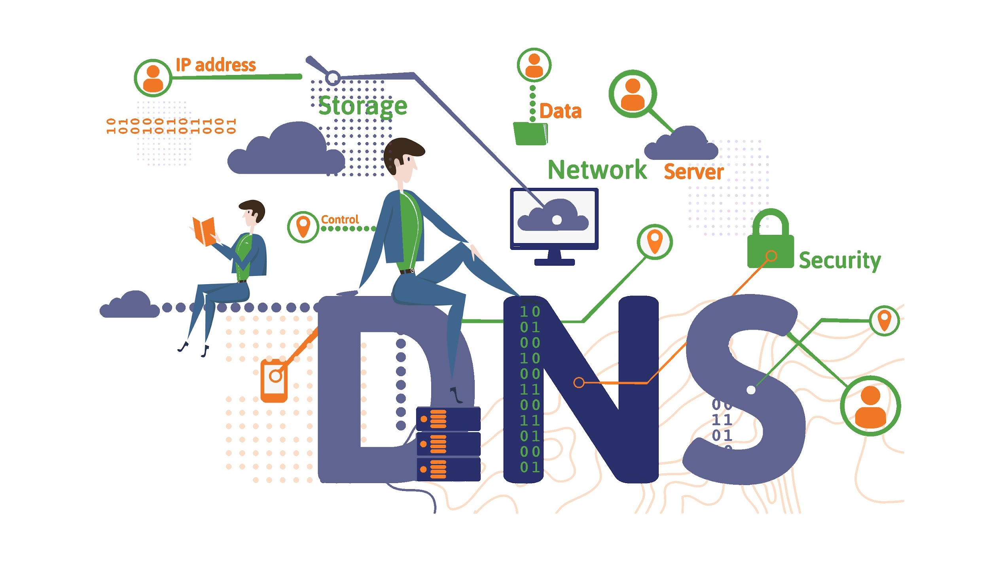
DNS Server
By Clement Chan
Notes:
Maybe introduce a helpful analogy?

Slide 2
The Domain Name Server (DNS) is the Achilles heel of the Web. The important thing is that it's managed responsibly.
Tim Berners-Lee

Slide 3
What is DNS?
Christo’s nickname
Notes:
Glad you asked

Slide 4
D -
N -
S -
If you mess it up,
you
screwed
Notes:
DNS stands for
(yes this is intentional)

Slide 5
DNS
Domain Name System
Translates domain names and IP addresses
Backbone of pretty much everything
Most servers depend on DNS to function properly

Slide 6
DNS Common Implementations
BIND
Berkeley’s, de-facto for Unix, more common
MS DNS
Microsoft’s, de-facto for Windows, core component of AD

Slide 7
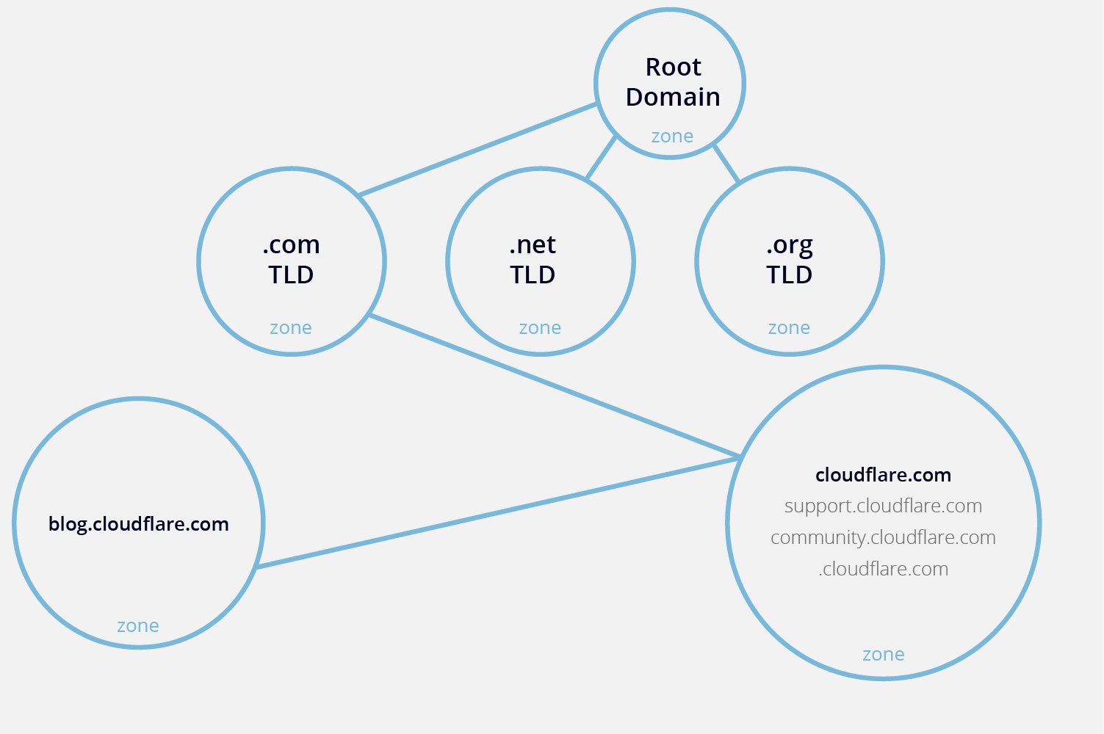
Some Terminology
Zone
Portion of domain name space
Zone transfer
Replicates DNS databases across DNS servers

Slide 8
DNS Dynamic Updates
Updates DNS records automatically when a new device joins the network or changes its IP address
Lessens administrative load
Home networks are under DHCP
Dynamic DNS allows you to link your changing home IP address to a custom domain name
You can use your hostname instead of your IP to connect to your home

Slide 9
DNS Name Server Types
All name servers store some type of DNS record
Your computer and the recursive DNS server have local caches to speed up the process for common sites like Youtube or Google
Root
Manage requests for top-level domains
Top-level
Contacts authoritative name servers
Authoritative
Stores DNS records for domain names
Recursive
Receives DNS queries and is responsible for finding an authoritative DNS server that can supply the IP address
Notes:
top-level = .com, .gov, .net etc
authoritative = google.com, irs.gov, etc

Slide 10
DNS Query Types
Recursive
Server will find IP on behalf of client, asking other DNS servers if it is not found in its local cache
Iterative
Server will check local cache; if not found, it will refer the client to another DNS server

Slide 11
DNS Query Types (cont.)
Forward DNS lookup
Find IP of a domain name
Reverse DNS lookup
Find domain name of an IP

Slide 12
DNS Record Types
A Domain to IP
CNAME Domain name alias/forwarding
MX Mail routing
TXT Information purposes
NS Authoritative nameserver identification
SOA Administrative info for zone transfers
SRV Service records
PTR IP to Domain
Notes:
CNAME is useful when running multiple services from one IP address
If the IP address changes, you only need to change one A record, instead of multiple A records

Slide 13
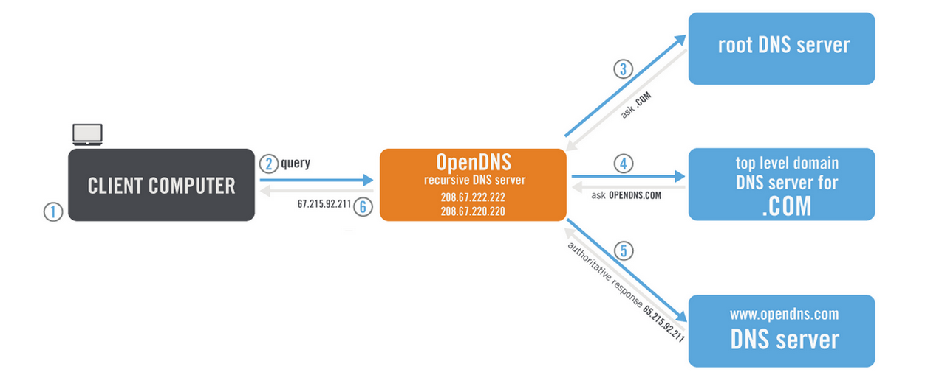
DNS Typical Process
3rd Process:
Client checks its own DNS cache
Recursive DNS nameserver checks its own DNS cache
Recursive DNS nameserver queries authoritative DNS nameservers

Slide 14

DNS Attacks and Security
checklist time!

Slide 15
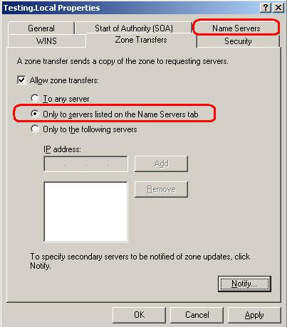
DNS Zone Transfers
nslookup can be used to obtain DNS records from DNS servers via zone transfers.
Zone transfers can expose a lot of information about your network.
You should limit who can ask for a zone transfer, or iust disable them completely.
Notes:
If you only have one DNS server and no name servers then you can just disable zone transfers

Slide 16
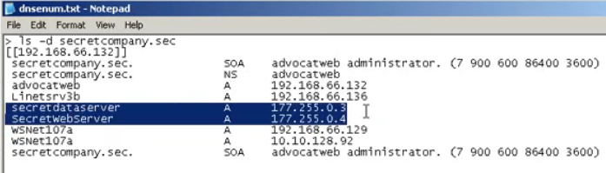
DNS Zone Transfer Attack
Recon in Play
DNS zone transfers can obtain extra information where scanning would be impossible to detect.
Highlighted section implies critical systems that are not in the same network, but DNS records expose them

Slide 17
DNS Dynamic Updates
Zone Poisoning
Hackers could pollute the DNS records if they are in a network where DNS servers allow nonsecure dynamic updates
Updates can be sent by a spoofed IP address to point a domain name to another IP address or create a fake malicious record
Notes:
DNS is UDP, so it won’t check if IP address is spoofed

Slide 18
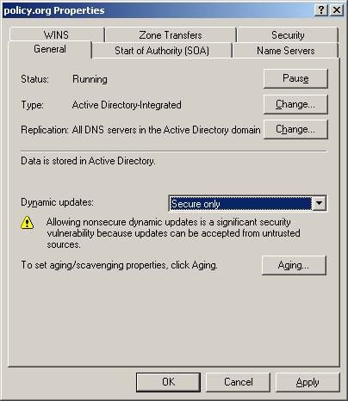
DNS Zone Poisoning
Mitigation
“Secure only” limits updates to only computers who join a domain or are in the domain (Kerberos authenticates the requests)
“None” requires manual updating of records
If only static IP addresses are used, set to this
“Nonsecure and secure” is used only if the DNS zone is not AD-integrated zone and if you want automatic updates

Slide 19

DNS Cache Poisoning
Malware can poison your DNS cache and redirect common sites to a malicious IP address instead.
View DNS resolver cache with ipconfig /displaydns
Run ipconfig /flushdns to clear your DNS cache.

Slide 20
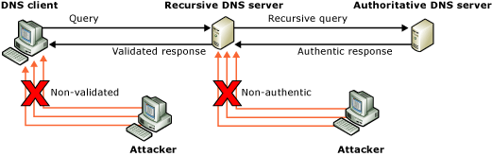
Other Considerations
DNSSEC - verification (prevents spoofing)
Uses public key cryptography
Creates DNSKEY, RRSIG and NSEC3 records

Slide 21
DNS DoS
Denial of Service
Allowing DNS recursion to resolve IPs outside the internal network can cause a DoS
Depends on company policy
If need to access Internet, leave recursion enabled
If DNS server is purely authoritative, disable recursion

Slide 22
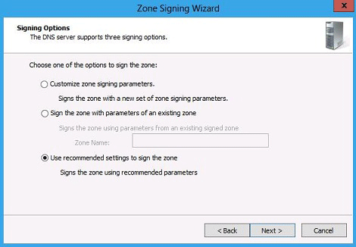
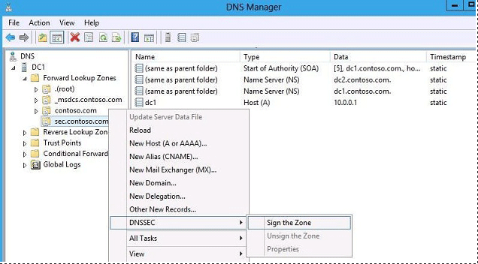

Slide 23

DNS Lab
Practice what you have learned

Slide 24
DNS Lab!
Via terminal:
Access google.com in a web browser via its IP address
Find the FQDN of 1.0.0.1
Obtain the MX records of google.com
Zone transfer the entire google.com zone to a file
On image:
Limit zone transfers
Allow only secure dynamic updates
Flush DNS cache
*use google to figure out the commands you need!

Slide 25
DNS Lab Guide
Exercise 1
Access google.com in a web browser via its IP address
Ping Google’s domain name to get their IP address
ping google.com
Alternatively, you can use nslookup
nslookup google.com
Enter the IP address in a web browser
IP result may vary, but should be within this:
172.217.0.0\19
Use a subnet calculator to figure out what this means!

Slide 26
DNS Lab Guide
Exercise 2
Find the FQDN of 1.0.0.1
Use nslookup
nslookup 1.0.0.1
one.one.one.one

Slide 27

DNS Lab Guide
Exercise 3
Obtain the MX records of google.com
Use nslookup
nslookup -type=mx google.com
OR
nslookup
> set type=mx
> google.com

Slide 28
DNS Lab Guide
Exercise 4
Zone transfer the entire google.com zone to a file
Get the nameservers of Google
nslookup
> set type=ns
> google.com
Set nameserver
> server <nameserver>
Set query to get all information
> set type=any
Zone transfer to a file
> ls -d google.com > output.txt
You won’t be able to zone transfer because the nameserver has probably denied zone transfers from anyone except a select few trusted DNS servers.

Slide 29
If DNS ain’t happy, ain’t nobody happy.

Slide 30
Credits
Special thanks to all the people who made and released these awesome resources for free:
Presentation template by SlidesCarnival

Slide 31
SlidesCarnival icons are editable shapes.
This means that you can:
Resize them without losing quality.
Change line color, width and style.
Isn’t that nice? :)
Examples:

